Slide 1

Project 2: Texas Career Insights
By: Toni Edwards, British Green, Reinhold Ndlovu and Shawna Truitt

Slide 2
Scope
The purpose of this project is to provide a way for analysts to easily access and share valuable career information with consumers. Final data can be used to make educated career selections based on various factors. The aggregation of data from multiple sources into a single database facilitates access to the following valuable insights:
Annual pay by experience level and Major Statistical Areas (MSAs) in Texas
Annual median and mean pay levels by MSAs in Texas
Educational Requirements for specific career categories
Projected Career Growth by career category in Texas

Slide 3
Data Sources
US Bureau of Labor Statistics
https://www.bls.gov/emp/tables/education-and-training-by-occupation.htm
TexasWages.com
2020 Annual MSA Wages: Mean
2020 Annual MSA Wages: Median
2020 Annual MSA Wages: Entry
2020 Annual MSA Wages: Experience
https://texaswages.com/MSAWages
2018 - 2028 Texas Employment Projections
https://texaswages.com/Projections

Slide 4

Database Management System
PostgreSQL
Relational Database Management System (DBMS)

Slide 5
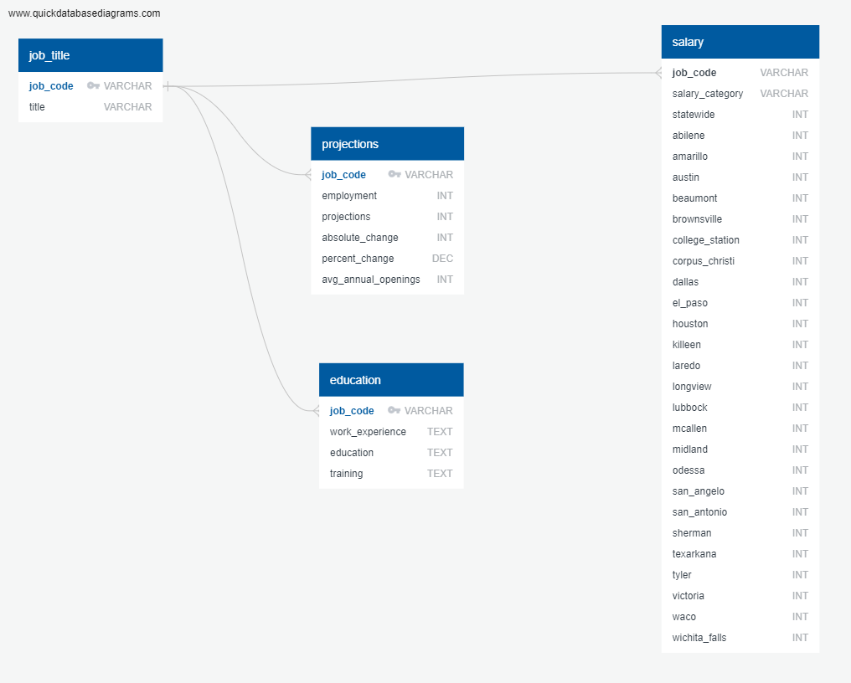
Database Schema
Database
employee_db
Tables:
job_title
projections
education
salary

Slide 6
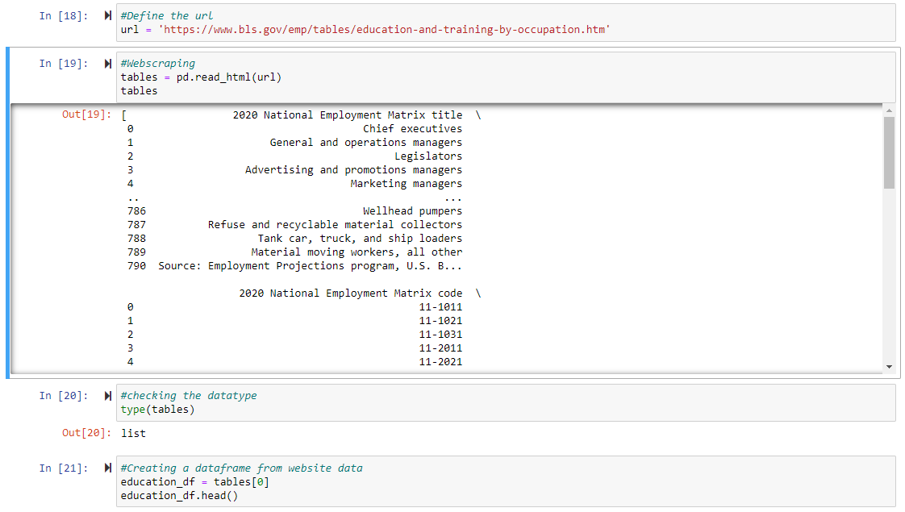
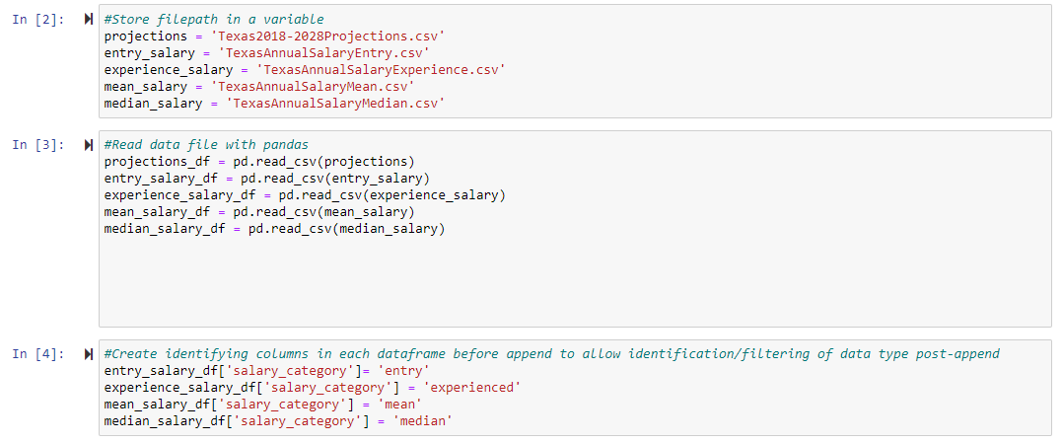
Extract
Data Sources
US Bureau of Labor Statistics Data (website)
Texas Workforce Commission Data (.csv)
Extraction Techniques:
Webscraping
Importing multiple .csv files

Slide 7
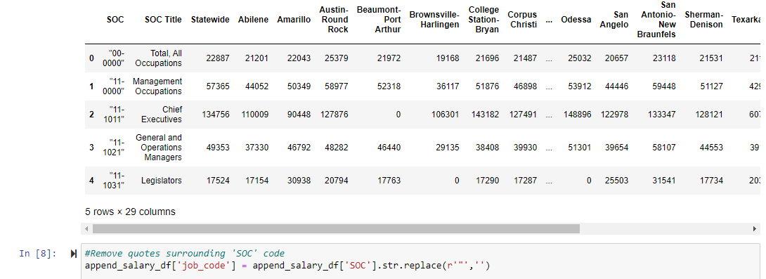
Transform - Cleaning
Removing quotes around ‘SOC column
Dropping Columns
Removing spaces from ‘job_code’ column
Removing duplicate items from dataframe
Removing unneeded column from dataframe

Slide 8
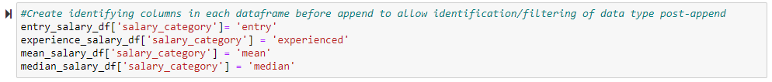
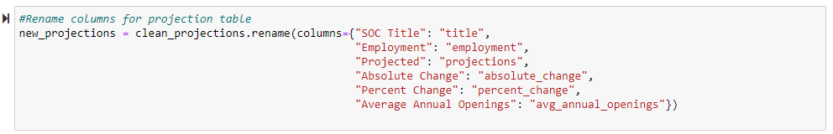
Transform – Restructuring
Add new columns in each dataframe before appending into single dataframe to specify salary category
Append four dataframes into one
Rename columns
Converting webscraped data into dataframe

Slide 9
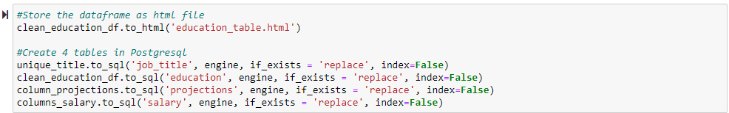
Loading
Loading Data to PostgreSQL DBMS
Connect to Postgresql employee_db database
Store education dataframe as html file and send data to PostgreSQL database

Slide 10
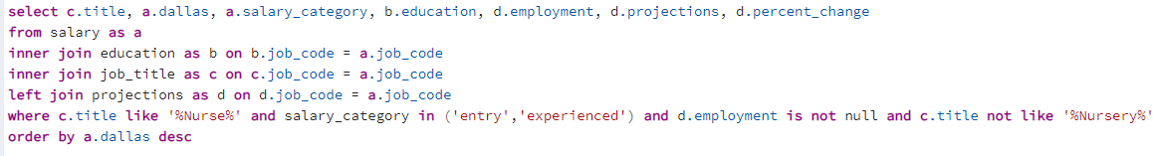
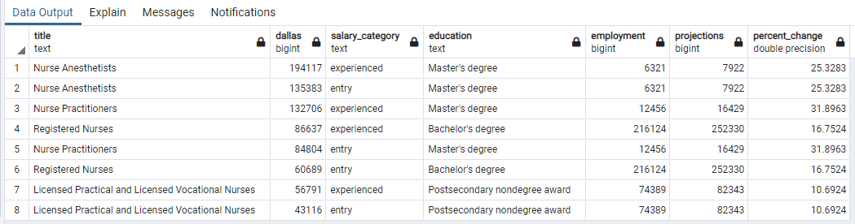
Analysis
Identifying salary, education requirements and employment projections for nurse job category in Dallas MSA

Slide 11
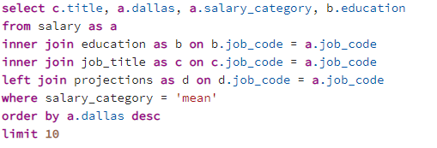
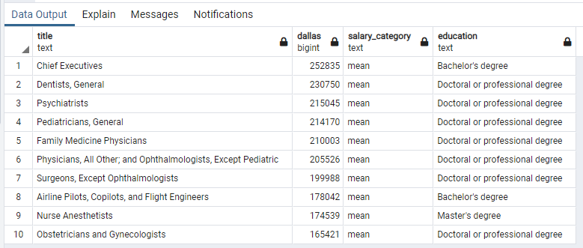
Analysis
Identify top 10 career categories in Dallas MSA by highest mean salaries; show typical education requirements

Slide 12
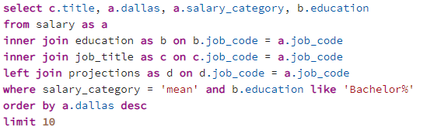
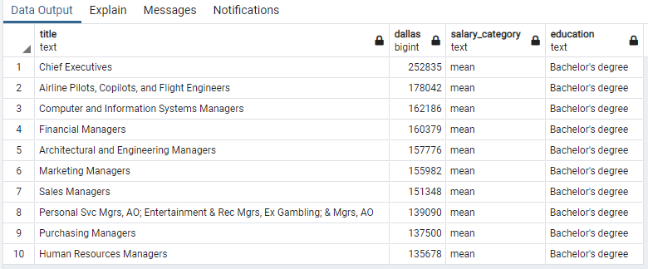
Analysis
Identify top 10 career categories in Dallas MSA by highest mean salaries that require a Bachelor’s degree

Slide 13
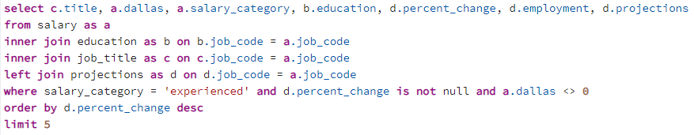
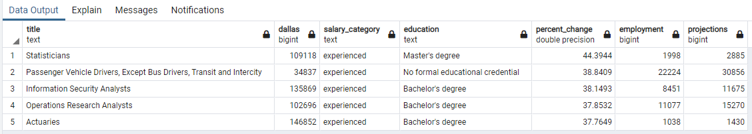
Analysis
Identify top 5 career fields in Texas by career growth projections

Slide 14
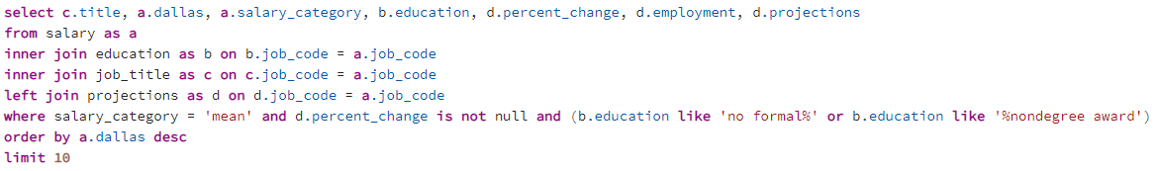
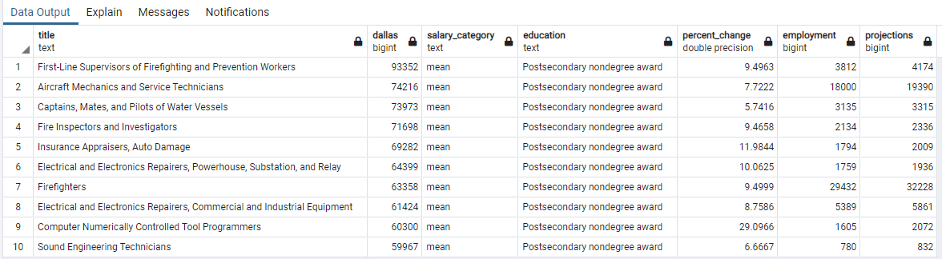
Analysis
Identify top 10 career categories by mean salary that don’t require a formal degree; identify career growth projections

Slide 15
Data Limitations
Data is from 2020 and may not depict current industry/career category information due to pandemic
Data is limited to the state of Texas
Major Statistical Area (MSA) Information is only available for salary data
Career category projection rates are at state-level
Data set does not include cost of living information which could provide more valuable decision-making capabilities

Slide 16
Results of Analysis/Conclusions
The highest paid career category in the Dallas MSA is Chief Executive
The Chief Executive career category requires a base education requirement of a Bachelor’s degree
The average salary for a Chief Executive in Dallas MSA is $252,835
Nurse Anesthetist is the highest paid in the nurse career field
Nurse Anesthetists have a base education requirement of a Master’s degree
The highest growth career category in Texas is Statistician
Salary in Dallas MSA for experienced statisticians is $109,118.

Slide 17

Project Objectives:
Project Proposal
The final README reflects the following:
Proposal cites at least two sources of data
Proposal includes the type of final production database to load the data into (relational or non-relational)
Gives relevant and succinct description of findings (2-3 sentences)
Project Report:
Extract: Indicates the original data sources and how the data was formatted
Transform: Explains what data clearing or transformation was required
Load: Explains final database, tables/collections, and why the topic was chosen
GitHub
Successfully uploaded to GitHub; demonstrating professional presentation
GitHub Repository is free of unnecessary files and folders and has an appropriate gitignore in use
The README is customized to a professional level

